Slide 1
Weekly report: Feedback Controller
Week number: 06
Date: 04/11/2025
Supervisor: Prof. Dr.-Ing. David Schlipf
Group members: Mirza Dincer, Saurabh Pankaj Jha, Midhun Kanichattu Venu
Presenter: Saurabh Pankaj Jha

Slide 2
List of Contents
Tasks of the Week
Kp and Ki optimization method over DLC 1.2
Signal Chain in Lidar – Assisted Controller
Conclusion
Mirza Dincer - 780261

Slide 3
Tasks of the Week
Optimization method for Kp and Ki for ROSCO input.
Understanding signal chain for Signal Chain in Lidar – Assisted Controller
Mirza Dincer - 780261

Slide 4
Kp and Ki Optimization Method
Kp, Ki and theta is a vector with a 30 number of elements in ROSCO input file.
It is time consuming to calculate Kp and Ki for each theta angle. Instead, an optimization method is used.
Ti will be kept constant to 1P time.
Start by choosing a starting point of Kp and theta, and neighbour points. Then convert this points to a vector for ROSCO input file and run DLC 1.2 simulation.
As a result, We will have a map with each point we selected with DEL and AEP, will search for the point where minimum DEL of tower base fore-aft bending moment and the AEP is maximum.
Mirza Dincer - 780261

Slide 5

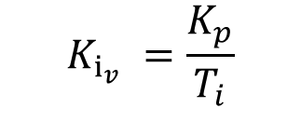
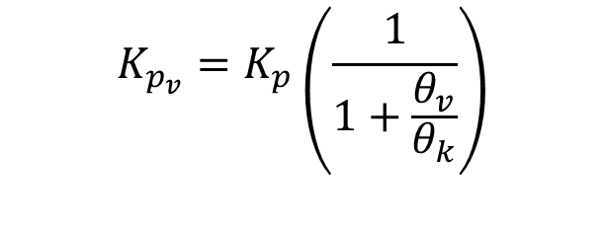

Kp and Ki Optimization Method
$θ_{v}$, $T_{i}$
$$K_{p_{v}}=K_{p}\left(\frac{1}{1+\frac{θ_{v}}{θ_{k}}}\right)$$
$K_{p}$, $θ_{k}$
Mapping
$$K_{i_{v}} =\frac{K_{p}}{T_{i}}$$
Mirza Dincer - 780261

Slide 6
DLC 1.2 Simulation Settings
660 seconds of simulation. Evaluation of values starts at t = 60 second to get settled values. Additionaly wind wraps around.
DLC 1.2 wind fields with average of 8 m/s to 24 m/s with steps with 4m/s, 3 seeds.
Enabled all DOFs.
Initial conditions of pitch angle, rotor speed and fore-aft tower position for every corresponding wind speed.
Running only feedback controller, no Lidar-assisted controller.
Mirza Dincer - 780261

Slide 7
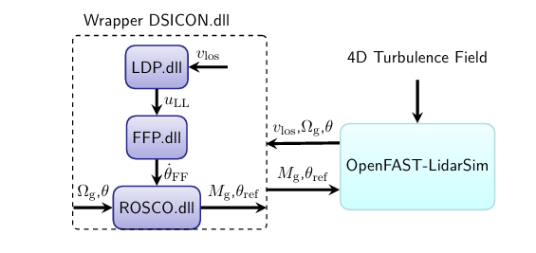
Signal Chain in Lidar – Assisted Controller
For the configuration of Lidar – Assisted Controller, wrapper dynamic library is used. Which runs the used DLLs in sequence.
Lidar Data Processing (LDP) DLL is used to estimate rotor effective wind speed (REWS).
Feedforward Pitch (FFP) DLL is used to provide feedforward pitch rate at correct time
The overall OpenFAST and LAC interface. [1]
[1], [2], [3]
Mirza Dincer - 780261

Slide 8
Signal Chain in Lidar – Assisted Controller
Lidar Line-of-Sight Wind Speed (vLOS) [m/s]
Lidar sensor measures wind velocity along its line-of-sight.
Represents wind conditions before reaching the rotor.
Preview Wind (uLL)
Derived from vLOS measurements through LDP.DLL.
Represents the predicted wind at the rotor disk.
Feedforward Pitch Rate (θ̇_FF) [rad/s]
Computed inside FFP.DLL based on preview wind uLL.
Defines how fast the blades should pitch in response to upcoming wind changes.
Pitch Command (θ_ref) [theta]
Final collective pitch command sent to blade actuators.
Combination of feedback (from speed error) and feedforward (from predicted wind).
[1], [2], [3]
Mirza Dincer - 780261

Slide 9
Conclusion
Script for optimization method will be ready for our Optimus turbine.
Understand signal chain in lidar and how it connects to ROSCO controller.
Next weeks:
Use optimization method for IEA 3.4 MW
How swap array works in Lidar – Assisted Controller
EOG gust simulations with Lidar – Assisted Controller
Mirza Dincer - 780261

Slide 10
Bibliography
[1] F. Guo, D. Schlipf, and Po Wen Cheng, “Evaluation of lidar-assisted wind turbine control under various turbulence characteristics,” Wind energy science, vol. 8, no. 2, pp. 149–171, Feb. 2023, doi: https://doi.org/10.5194/wes-8-149-2023.
[2] D. Schlipf, E. Simley, F. Lemmer, L. Pao, and P. W. Cheng, “Collective Pitch Feedforward Control of Floating Wind Turbines Using Lidar,” Journal of Ocean and Wind Energy, vol. 2, no. 4, Nov. 2015, doi: https://doi.org/10.17736/jowe.2015.arr04.
[3] F. Dunne, L. Y. Pao, A. D. Wright, B. Jonkman, and N. Kelley, “Adding feedforward blade pitch control to standard feedback controllers for load mitigation in wind turbines,” Mechatronics, vol. 21, no. 4, pp. 682–690, Apr. 2011, doi: https://doi.org/10.1016/j.mechatronics.2011.02.011.
Mirza Dincer - 780261

